Slide 1
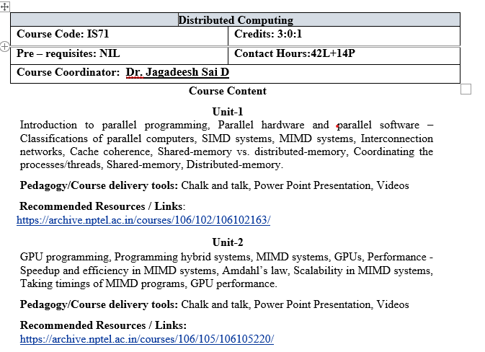

Slide 2
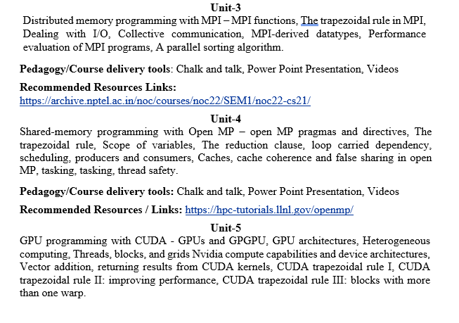

Slide 3
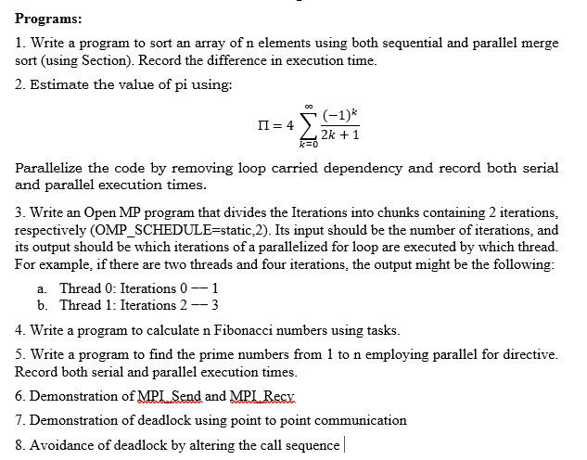

Slide 4
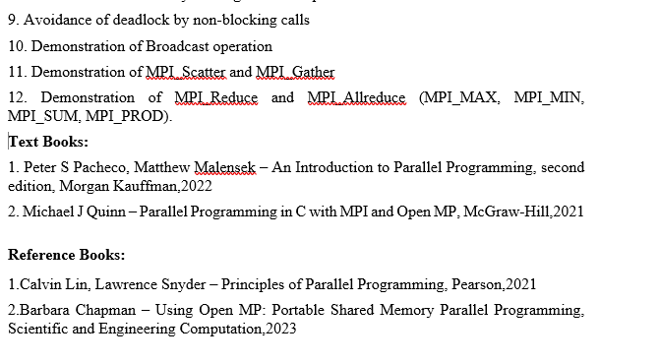

Slide 5
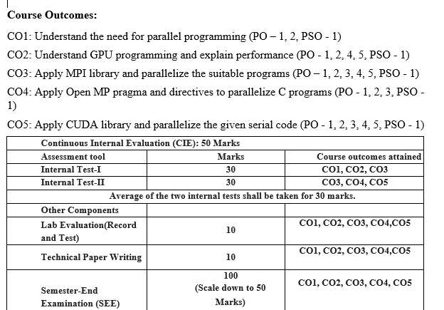

Slide 6
Distributed computing is a branch of computer science that deals with the design and implementation of systems where computing resources, such as processors, memory, and storage, are spread across multiple computers but work together to achieve a common goal. Instead of relying on a single powerful machine, distributed computing uses a network of interconnected computers (called nodes) to solve complex problems more efficiently and reliably.
Distributed computing enables computers to collaborate over networks, making systems faster, scalable, and more reliable.
Key Characteristics:
Multiple Nodes: Involves more than one computer working together.
Resource Sharing: Nodes share hardware, software, and data resources.
Concurrency: Tasks can be performed simultaneously across multiple systems.
Scalability: Easy to add or remove machines to handle workload changes.
Fault Tolerance: Even if one node fails, the system continues functioning.

Slide 7
Aspect | Distributed Computing | Parallel Programming
Definition | A model where computation is carried out across multiple computers (nodes) connected by a network, working together to solve a problem. | A model where a single problem is divided into smaller subproblems and executed simultaneously on multiple processors/cores of the same computer.
Hardware | Uses multiple independent systems connected by a network. | Uses multiple CPUs/cores within a single system (shared memory or tightly coupled).
Communication | Nodes communicate via message passing over a network. | Processes/threads communicate via shared memory (or sometimes message passing in multiprocessors).
Fault Tolerance | High — if one machine fails, others can continue. | Low — if the main system fails, the whole process usually stops.
Scalability | Highly scalable — new computers can be added to the network. | Limited scalability — restricted to the number of processors/cores in a single machine.
Examples | Internet, Hadoop, Cloud computing, Blockchain, Distributed databases. | Matrix multiplication using multiple CPU cores, GPU programming, OpenMP, MPI (on a single cluster).
Focus | Coordination of independent systems and handling communication delays, failures, and consistency. | Speeding up execution of a program by splitting tasks across multiple processors.

Slide 8
Parallel programming is a method of computation in which many calculations or processes are carried out simultaneously. Instead of executing tasks one after another (sequential programming), parallel programming divides a large problem into smaller subproblems and executes them at the same time on multiple processors or cores within a single computer system.
This approach helps achieve faster execution, efficient resource utilization, and the ability to solve complex, computation-heavy problems that would take too long if run sequentially.
Key Characteristics
1. Concurrency – Multiple tasks run at the same time.
2. Decomposition – Problems are divided into smaller sub-tasks.
3. Synchronization – Ensures tasks work correctly when sharing data.
Shared Memory/Communication – Tasks either share the same memory (threads) or use message passing to coordinate.
Types of Parallelism
1.Data Parallelism – Same operation performed on different pieces of data (e.g., image processing).
2.Task Parallelism – Different tasks or functions executed in parallel (e.g., pipeline processing)
Advantages
• Speeds up computation.
• Efficient utilization of multicore processors.
• Solves large-scale scientific and engineering problems.

Slide 9
Difference between CPU and a GPU for parallel computing
GPU is very good at data-parallel computing, CPU is very good at parallel processing.
GPU has thousands of cores, CPU has less than 100 cores.
GPU has around 40 hyperthreads per core, CPU has around 2(sometimes a few more) hyperthreads per core.
GPU has difficulty executing recursive code, CPU has less problems with it.
GPU lowest level caches are shared between 8–24 cores for intel, 64 cores for amd and up to 192 cores for nvidia. CPU’s lowest level cache only used by single core (2 threads). CPU’s each thread can use SIMD which is data-parallel for about 8–32 workitems(each comparable to a single GPU core/thread).
GPU highest level cache is only around 5MB, CPU highest level cache can get 64MB or more.

Slide 10
GPU highest level cache is only around 5MB, CPU highest level cache can get 64MB or more.
GPU is accessed through pci-e and similar bridges and also works on a middle API that both add latency and programming effort and makes very lighty loaded works become slow. CPU is easier to begin with and perfect at random + small workloads.
GPU has considerably higher compute per electricity energy than CPU.
GPU is for high throughput, CPU is for low latency.
With APIs like CUDA/OpenCL, GPU has addressable local memories and registers that are much faster than lowest level caches. This makes inter-core communication easier in coding. Even number of available (and addressable like an array) private registers per core is much higher than that of a CPU. (256 vs 32)
GPU’s single core is very lightweight compared to a single CPU core.

Slide 11
Aspect | OpenMP | MPI
Full Form | Open Multi-Processing | Message Passing Interface
Memory Model | Shared memory (all threads share the same address space). | Distributed memory (each process has its own memory; communication via messages).
Programming Style | Thread-based parallelism (uses compiler directives like #pragma). | Process-based parallelism (explicit message passing between processes).
Scalability | Limited to a single machine with multiple cores/CPUs. | Scales well across clusters with thousands of nodes.
Ease of Use | Easier to program (simple directives). | More complex (requires explicit send/receive calls).
Communication | Implicit (threads share memory). | Explicit (messages must be exchanged).
Best Suited For | Multicore desktops, shared-memory servers. | Large-scale supercomputers, distributed clusters.
Example | Parallelizing loops in C/C++/Fortran using #pragma omp parallel for. | Running a scientific simulation across multiple computers in a cluster.
OpenMP = Best for shared memory, small-scale parallelism.
MPI = Best for distributed memory, large-scale parallelism

Slide 12
Introduction to CUDA Programming:
CUDA (Compute Unified Device Architecture) is a parallel computing platform and API developed by NVIDIA.
It allows developers to use a Graphics Processing Unit (GPU) for general-purpose computing (GPGPU), not just for graphics.
CUDA provides extensions to languages like C, C++, Fortran, Python, and Java, making it possible to write programs that run directly on NVIDIA GPUs.
Traditional CPUs have a few powerful cores → good for sequential tasks.
GPUs have thousands of smaller, efficient cores → excellent for parallel tasks.
CUDA helps in:
High-performance scientific computing
Machine learning and deep learning
Image/video processing
Data mining and simulations
A CPU has a few cores (4–16 typically) optimized for sequential tasks.
A GPU has thousands of smaller, efficient cores designed for parallel execution.
This makes GPUs ideal for problems where the same operation is applied to a large dataset at once

Slide 13
GPU in Different Devices:
Desktops → Dedicated graphics card (big, visible).
Laptops → GPUs are soldered onto the motherboard (not visible separately).
Servers / Data Centers → Massive GPU units (like NVIDIA A100, H100) designed for AI and HPC.
Mobile phones → Tiny integrated GPUs inside the SoC (e.g., Adreno, Mali).

Slide 14
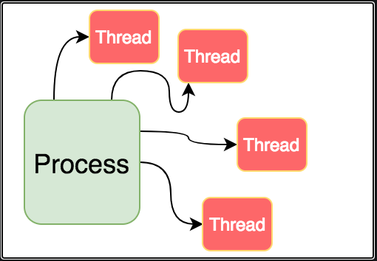
Threads
Threads are contained within processes.
They allow programmers to divide their programs into (more or less) independent tasks.
The hope is that when one thread blocks because it is waiting on a resource, another will have work to do and can run.

Slide 15
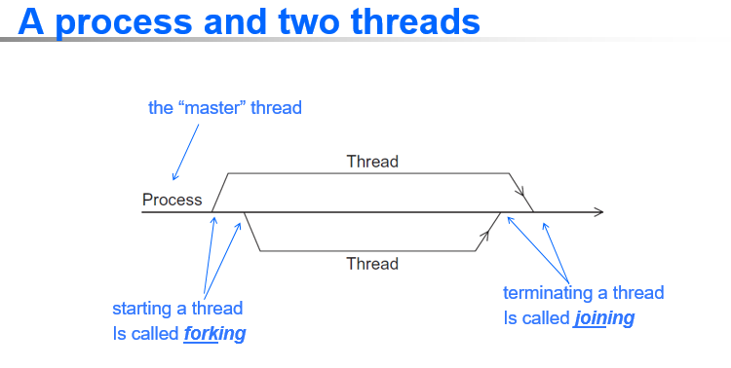

Slide 16
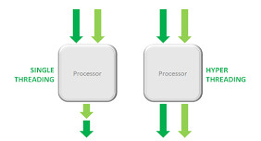
Hyper-threading is a hardware technology that allows a single processor to handle multiple tasks simultaneously, which can improve performance.
It does this by dividing a CPU's physical cores into virtual cores, also known as threads, that the operating system treats as if they were physical cores.

Slide 17
Why use parallelism for APIs?
One of the main reasons to use parallelism for API’s(Application Programming Interface) is to improve the performance and scalability of your applications.
By sending and receiving multiple requests and responses at the same time, you can reduce the waiting time and increase the throughput of your applications.
For example, fetch data from several APIs,

Slide 18
Why use parallelism for APIs?
Another reason to use parallelism for APIs is to handle complex or dynamic scenarios that require coordination or synchronization among multiple APIs.
For example, Perform a transaction.
This can make your applications more reliable and consistent.

Slide 19
Why use parallelism for APIs?
Another reason to use parallelism for APIs is to handle complex or dynamic scenarios that require coordination or synchronization among multiple APIs.
For example, Perform a transaction.
This can make your applications more reliable and consistent.

Slide 20
An intelligent solution
Instead of designing and building faster microprocessors, put multiple processors on a single integrated circuit.

Slide 21
Now it’s up to the programmers
Adding more processors doesn’t help much if programmers aren’t aware of them…
… or don’t know how to use them.
Serial programs don’t benefit from this approach (in most cases).

Slide 22
Why we need ever-increasing performance
As our computational power increases, the number of problems that we can seriously consider solving also increases.
Examples like

Slide 23

Climate modeling
In order to better understand climate change, we need far more accurate computer models, models that include interactions between the atmosphere, the oceans, solid land, and the ice caps at the poles.

Slide 24
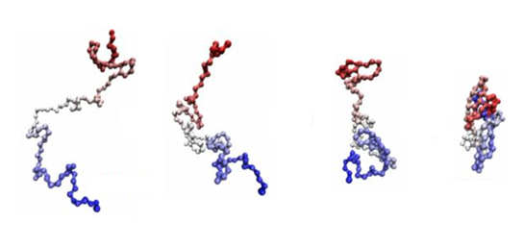
Protein folding
It’s believed that misfolded proteins may be involved in diseases such as Huntington’s, Parkinson’s, and Alzheimer’s, but our ability to study configurations of complex molecules such as proteins is severely limited by our current computational power.

Slide 25


Drug discovery
There are many drugs that are effective in treating a relatively small fraction of those suffering from some disease. It’s possible that we can devise alternative treatments by careful analysis of the genomes of the individuals for whom the known treatment is ineffective. This, however, will involve extensive computational analysis of genomes.

Slide 26


Energy research
Increased computational power will make it possible to program much more detailed models of technologies such as wind turbines, solar cells, and batteries. These programs may provide the information needed to construct far more efficient clean energy sources.

Slide 27



Data analysis
We generate tremendous amounts of data. By some estimates, the quantity of data stored worldwide doubles every two years, but the vast majority of it is largely useless unless it’s analyzed.

Slide 28
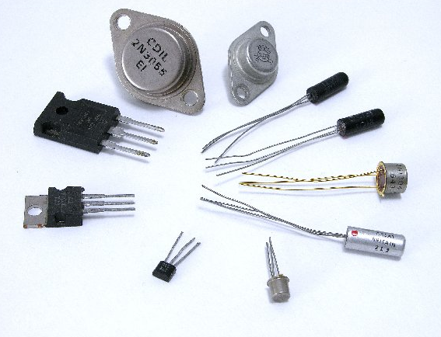
Why we’re building parallel systems
Up to now, performance increases have been attributable to increasing density of transistors.
But there are inherent problems.

Slide 29
Smaller transistors = faster processors.
Faster processors = increased power consumption.
Increased power consumption = increased heat.
Increased heat = unreliable processors.

Slide 30
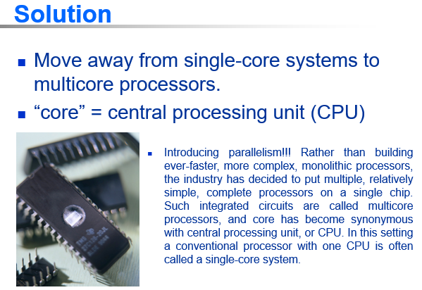

Slide 31
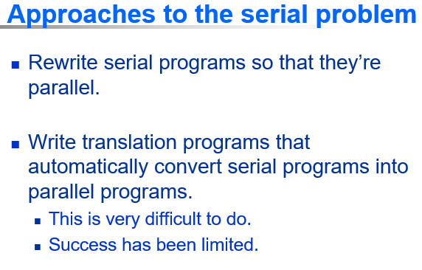

Slide 32
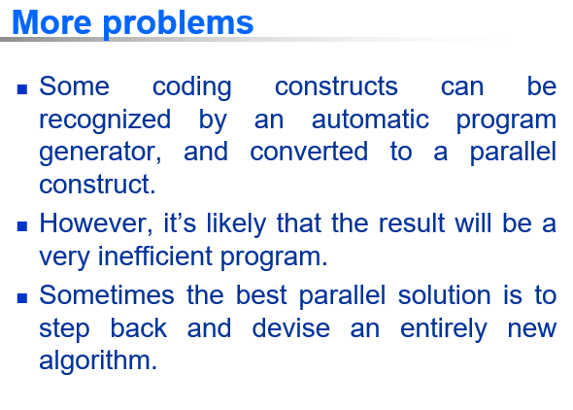

Slide 33
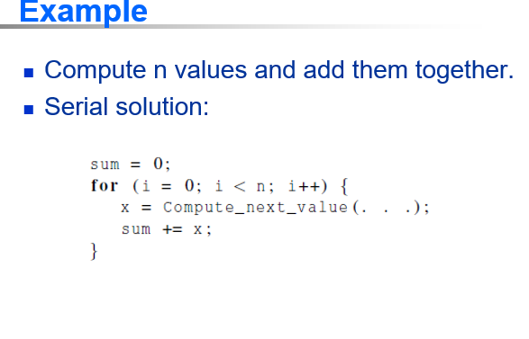

Slide 34
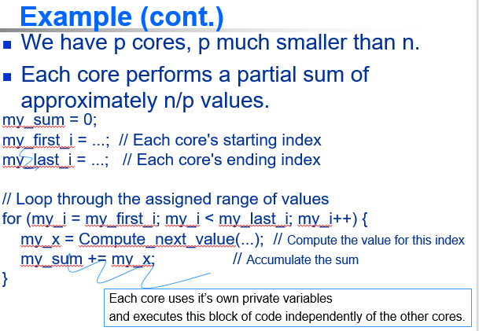

Slide 35
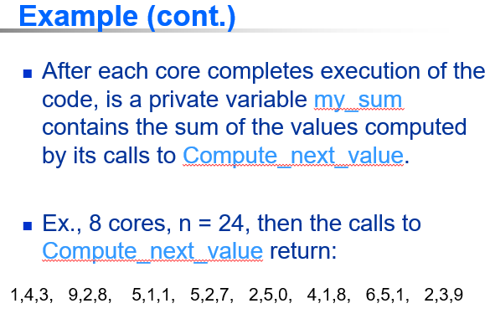

Slide 36
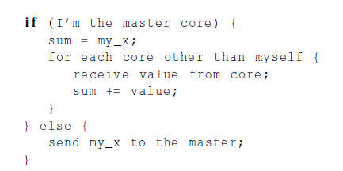
Example (cont.)
Once all the cores are done computing their private my_sum, they form a global sum by sending results to a designated “master” core which adds the final result.

Slide 37
Example (cont.)
if (I’m the master core) {
// Initialize sum with the master's own value
sum = my_sum;
// Loop through all other cores and receive their values
for each core other than myself {
received_value = receive_value_from_core(core_id);
sum += received_value;
}
// Final sum is computed at the master
} else {
// Worker cores send their sum to the master
send_value_to_master(my_sum);
}

Slide 38
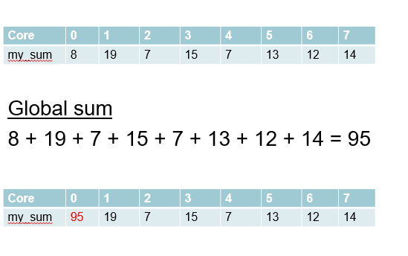
Example (cont.)

Slide 39
Better parallel algorithm
Don’t make the master core do all the work.
Share it among the other cores.
Pair the cores so that core 0 adds its result with core 1’s result.
Core 2 adds its result with core 3’s result, etc.
Work with odd and even numbered pairs of cores.

Slide 40
Better parallel algorithm
Repeat the process now with only the evenly ranked cores.
Core 0 adds result from core 2.
Core 4 adds the result from core 6, etc.
Now cores divisible by 4 repeat the process, and so forth, until core 0 has the final result.

Slide 41
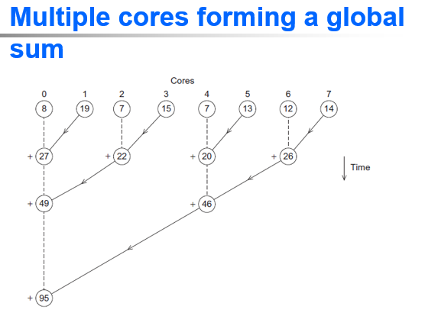

Slide 42
Analysis
In the first example, the master core performs 7 receives and 7 additions.
In the second example, the master core performs 3 receives and 3 additions.
The improvement is more than a factor of 2!

Slide 43
Analysis (cont.)
The difference is more dramatic with a larger number of cores.
If we have 1000 cores:
The first example would require the master to perform 999 receives and 999 additions.
The second example would only require 10 receives and 10 additions.
That’s an improvement of almost a factor of 100!

Slide 44
Partitioning of the work can be done among the cores.
Task parallelism
Partition various tasks carried out in solving the problem among the cores.
Data parallelism
Partition the data used in solving the problem among the cores.
Each core carries out similar operations on it’s part of the data.

Slide 45


Slide 46


Slide 47
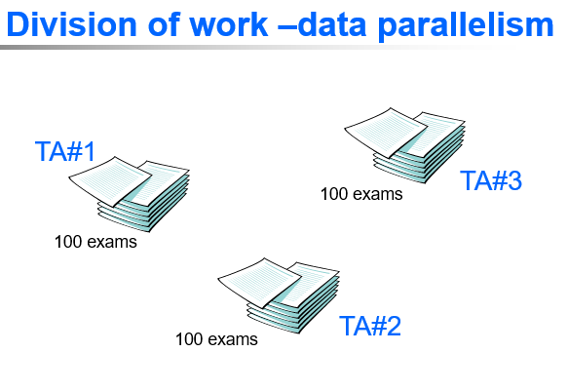

Slide 48
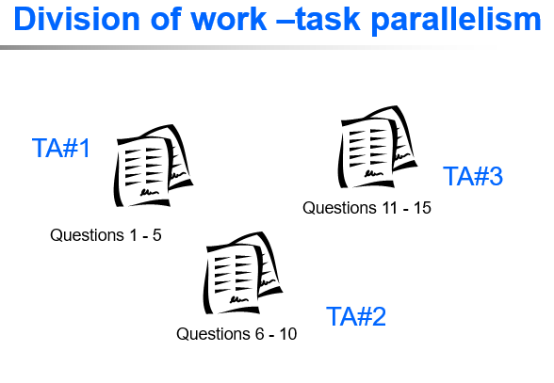

Slide 49
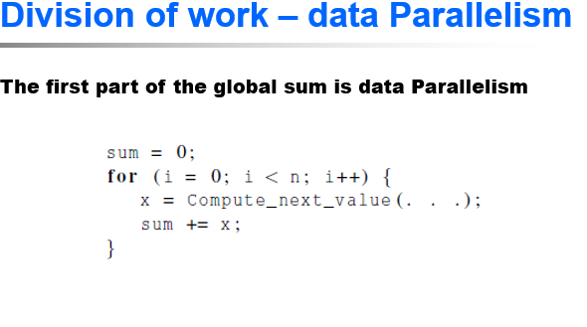
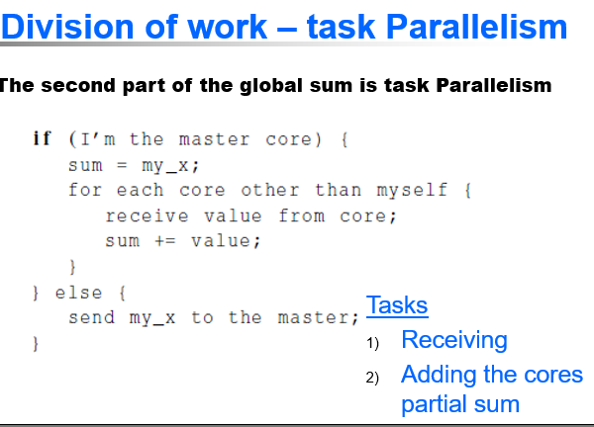

Slide 50
There are two tasks: receiving and adding the cores’ partial sums, which is carried out by the master core and giving the partial sum to the master core, which is carried out by the other cores.

Slide 51
Coordination
In both global sum examples, the coordination involves
Communication – one or more cores send their current partial sums to another core.
Load balancing – share the work evenly among the cores so that one is not heavily loaded.
Synchronization – because each core works at its own pace, make sure cores do not get too far ahead of the rest.

Slide 52
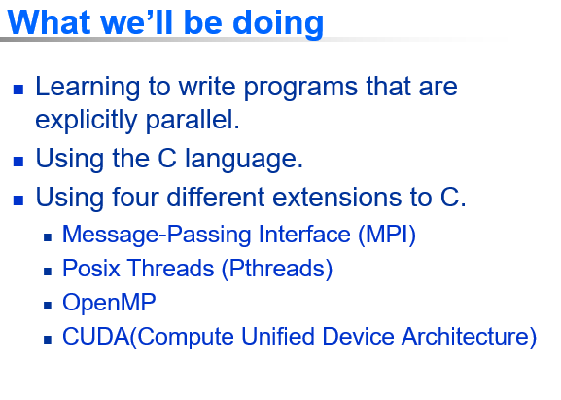

Slide 53
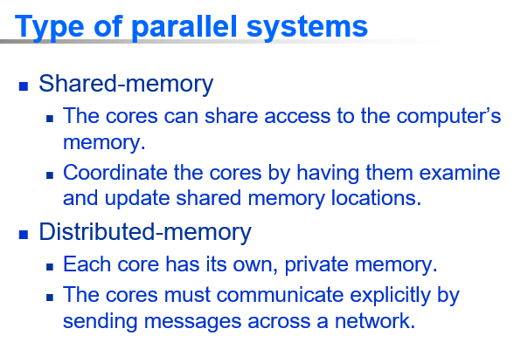

Slide 54
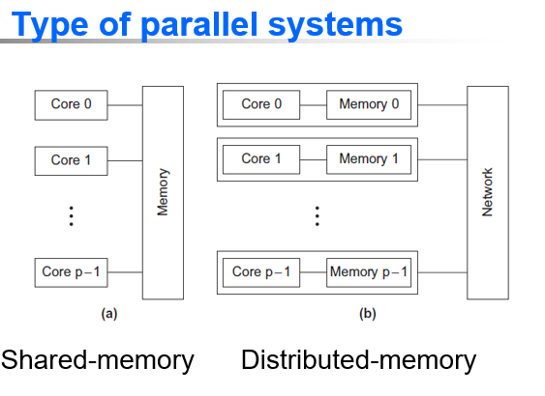

Slide 55
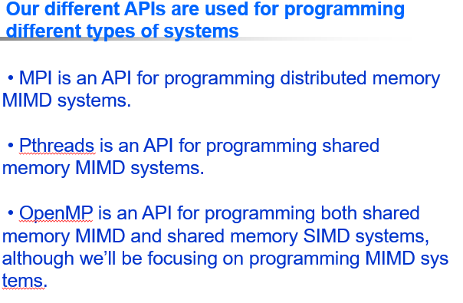

Slide 56
• CUDA: is an API for programming Nvidia GPUs,
which have aspects of all four of our classifications: shared memory and distributed memory, SIMD, and MIMD. We will, however, be focusing on the shared memory SIMD and MIMD aspects of the API.

Slide 57
Concurrent,Parallel,Distributed
Concurrent computing – a program is one in which multiple tasks can be in progress at any instant.
Parallel computing – a program is one in which multiple tasks cooperate closely to solve a problem
Distributed computing – a program may need to cooperate with other programs to solve a problem.

Slide 58
Some benefits of using parallel APIs:
Faster response times
Parallel APIs can lead to faster response times, which can improve the user experience.
Optimized resource utilization
Parallel APIs can optimize resource utilization by enabling simultaneous data retrieval.
Handling complex scenarios
Parallel APIs can handle complex or dynamic scenarios that require coordination or synchronization among multiple APIs

Slide 59
Parallel Hardware
and
Parallel Software

Slide 60
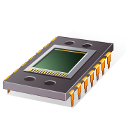
Parallel hardware

Slide 61
Classifications of parallel Computers
Flynn’s Taxonomy
(SIMD)
Single instruction stream
Multiple data stream
SISD
Single instruction stream
Single data stream
MISD
Multiple instruction stream
Single data stream
(MIMD)
Multiple instruction stream
Multiple data stream
not covered

Slide 62
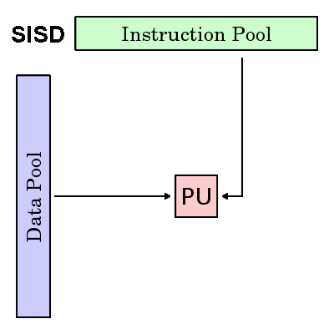
Single Instruction, Single Data (SISD)
Serial (non-parallel) computer
Single Instruction: Only one instruction stream is being acted on by the CPU during any one clock cycle
Single Data: Only one data stream is being used as input during any one clock cycle

Slide 63
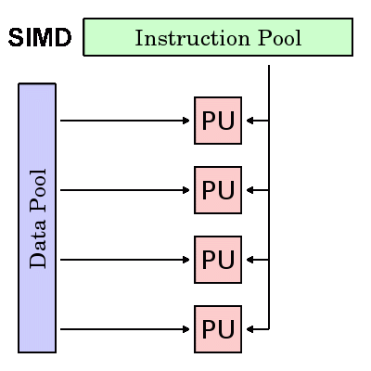
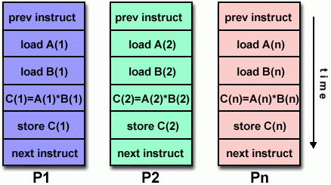
Single Instruction, Multiple Data (SIMD)

Slide 64
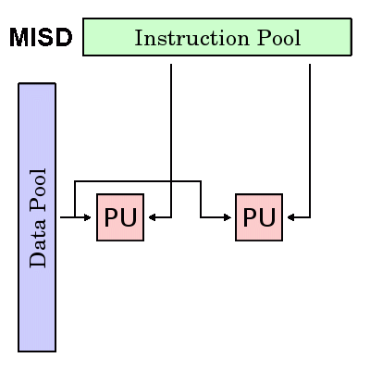
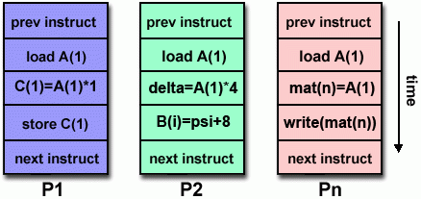
Multiple Instruction, Single Data (MISD)

Slide 65
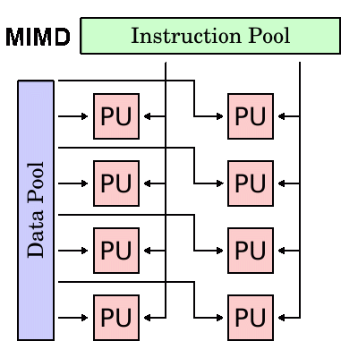
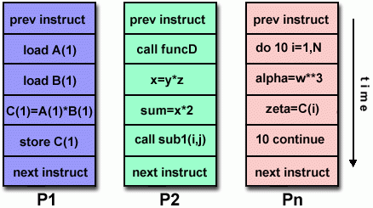
Multiple Instruction, Multiple Data (MIMD)

Slide 66
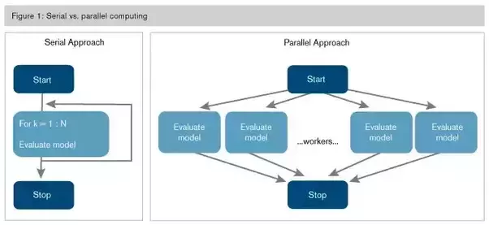

Slide 67
Alternative classification based on how the core access memory
In shared memory systems, the cores can share access to memory locations, and the cores coordinate their work by modifying shared memory locations.
In distributed memory systems, each core has its own, private memory, and the cores coordinate their work by communicating across a network.

Slide 68
SIMD
Parallelism achieved by dividing data among the processors.
SIMD systems operate on multiple data streams by applying the same instruction to multiple data items, so SIMD system can be thought of as having a single control unit and multiple data paths.
Parallelism that’s obtained by dividing data among the processors and having the processors all apply (more or less) the same instructions to their subsets of the data is called data-parallelism.

Slide 69
SIMD example
n data items
n ALUs
control unit
…
x[1]
x[2]
x[n]
ALU₁
ALU₂
ALU_{n}
for (i = 0; i < n; i++)
x[i] += y[i];

Slide 70
SIMD
What if we don’t have as many ALUs as data items?
Divide the work and process iteratively.
Ex. m = 4 ALUs and n = 15 data items.
Round3 | ALU₁ | ALU₂ | ALU₃ | ALU₄
1 | X[0] | X[1] | X[2] | X[3]
2 | X[4] | X[5] | X[6] | X[7]
3 | X[8] | X[9] | X[10] | X[11]
4 | X[12] | X[13] | X[14]

Slide 71
SIMD drawbacks
SIMD drawbacks
All ALUs are required to execute the same instruction, or remain idle.
In classic design, they must also operate synchronously.
The ALUs have no instruction storage.
Efficient for large data parallel problems, but not other types of more complex parallel problems.
The only widely produced SIMD systems were vector processors

Slide 72
Vector processors
Operate on arrays or vectors of data while conventional CPU’s operate on individual data elements or scalars.
Conventional CPUs (Scalar Processors)
A normal CPU works on scalars single data elements at a time.
Example: If you want to add two arrays of 1000 numbers, the CPU will usually add one pair of numbers at a time in a loop.
Instruction: Add A[0] + B[0]
Add A[1] + B[1]
Add A[2] + B[2]
This is sequential, slower for large datasets.

Slide 73
Vector processors
A vector processor works on vectors (arrays of data) in one instruction.
Instead of handling one number at a time, it processes an entire array (or a chunk of it) at once.
Example: Adding two arrays of 1000 numbers can be done with one vector instruction that tells the hardware:
Typical recent systems have the following characteristics:
Vector registers: Capable of storing a vector of operands and operating simultaneously on their contents. The vector length is fixed by the system, and can range from 4 to 256, 64-bit elements.

Slide 74
Vector processors (2)
Vectorized and pipelined functional units.
The same operation is applied to each element in the vector (or pairs of elements). or, in the case of operations like addition, the same operation is applied to each pair of corresponding elements in the two vectors. Thus vector operations are SIMD.
Vector instructions.
Operate on vectors rather than scalars.
for (i = 0; i < n; i++)
x [i] += y[i];
requires only a single load, add, and store for each block of vector length elements, while a conventional system requires a load, add, and store for each element.

Slide 75
Vector processors (3)
Interleaved memory.
Multiple “banks” of memory, which can be accessed more or less independently.
Distribute elements of a vector across multiple banks, so reduce or eliminate delay in loading/storing successive elements.
Strided memory access and hardware scatter/gather.
The program accesses elements of a vector located at fixed intervals.

Slide 76
Vector processors - Pros
Very fast and easy to use.
Vectorizing compilers are good at identifying code that can be vectorized.
Compilers also can provide information about code that cannot be vectorized.
Helps the programmer re-evaluate code.
High memory bandwidth.
Uses every item in a cache line.

Slide 77
Vector processors - Cons
They don’t handle irregular data structures as well as other parallel architectures.
A very finite limit to their ability to handle ever larger problems. (scalability)

Slide 78
Graphics Processing Units (GPU)
Real time graphics application programming interfaces or API’s use points, lines, and triangles to internally represent the surface of an object.

Slide 79
GPUs
A graphics processing pipeline converts the internal representation into an array of pixels that can be sent to a computer screen.
Several stages of this pipeline (called shader functions) are programmable.
shader functions are typically just a few lines of C code.

Slide 80
GPUs
Shader functions are also implicitly parallel, since they can be applied to multiple elements in the graphics stream. GPU’s can often optimize performance by using SIMD parallelism.
The current generation of GPU’s use SIMD parallelism.
GPU’s are not pure SIMD systems. Although the data paths on a given core can use SIMD parallelism, current generation GPUs can run more than one instruction stream on a single core.

Slide 81
GPUs
Typical GPUs can have dozens of cores, and these cores are also capable of executing independent instruction streams.
So GPUs are neither purely SIMD nor purely MIMD.
Also note that GPUs can use shared or distributed memory. The largest systems often use both: several cores may have access to a common block of memory, but other SIMD cores may have access to a different block of shared memory, and two cores with access to different blocks of shared memory may communicate over a network.

Slide 82
MIMD
Supports multiple simultaneous instruction streams operating on multiple data streams.
Typically consist of a collection of fully independent processing units or cores, each of which has its own control unit and its own ALU.
MIMD systems are usually asynchronous, that is, the processors can operate at their own pace.

Slide 83
Shared Memory System
A collection of autonomous processors is connected to a memory system via an interconnection network.
Each processor can access each memory location.
The processors usually communicate implicitly by accessing shared data structures.

Slide 84
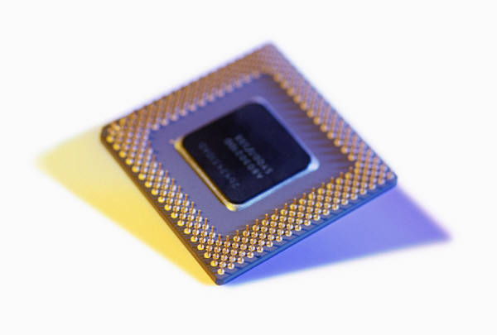
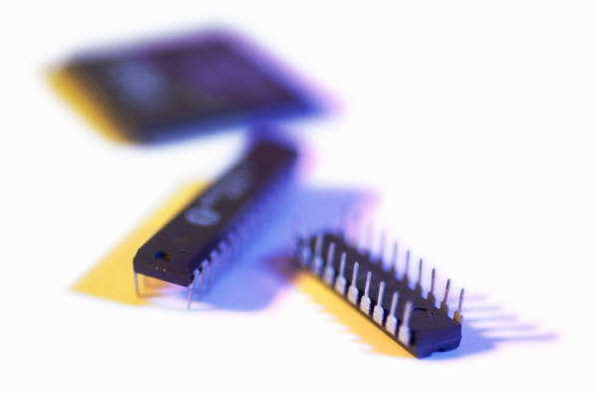
Shared Memory System (2)
Most widely available shared memory systems use one or more multicore processors.
(multiple CPU’s or cores on a single chip)

Slide 85
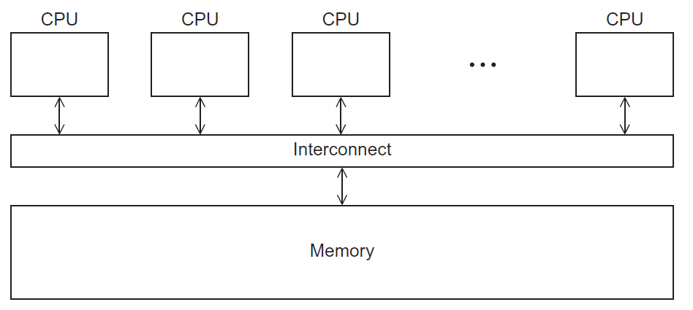
Shared Memory System
Figure 2.3

Slide 86
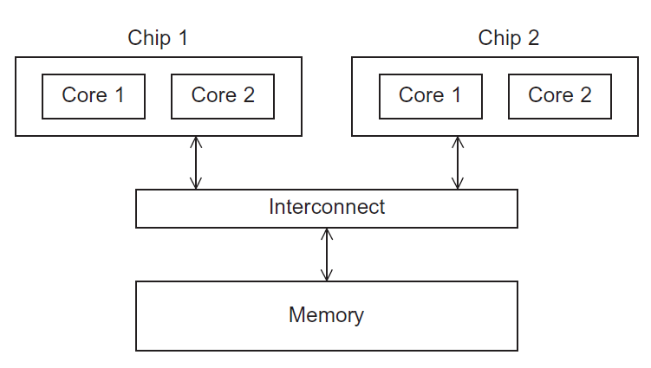
UMA(uniform memory access) multicore system
Figure 2.5
In this type of system, the time to access all the memory locations will be the same for all the cores.

Slide 87
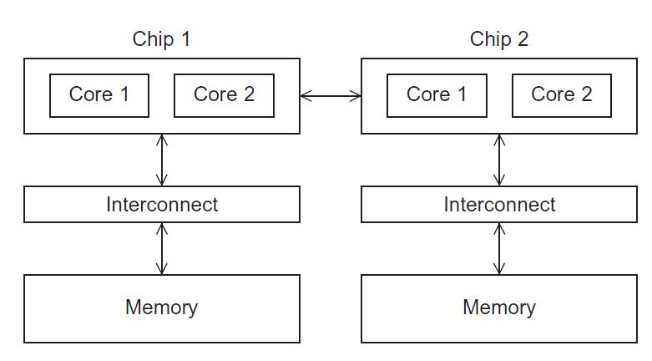
NUMA multicore system:
Figure 2.6
A memory location a core is directly connected to can be accessed faster than a memory location that must be accessed through another chip.

Slide 88
Distributed Memory System:
The most widely available distributed-memory systems are called clusters
A collection of commodity systems.
Connected by a commodity interconnection network. for example: Ethernet.
The nodes of these systems, the individual computational units joined together by the communication network, are usually shared-memory systems with one or more multicore processors.

Slide 89
Distributed Memory System
To distinguish such systems from pure distributed-memory systems, they are sometimes called hybrid systems. Nowadays, it’s usually understood that a cluster has shared-memory nodes.
The grid provides the infrastructure necessary to turn large networks of geographically distributed computers into a unified distributed-memory system.
In general, such a system is heterogeneous, that is, the individual nodes are built from different types of hardware.

Slide 90
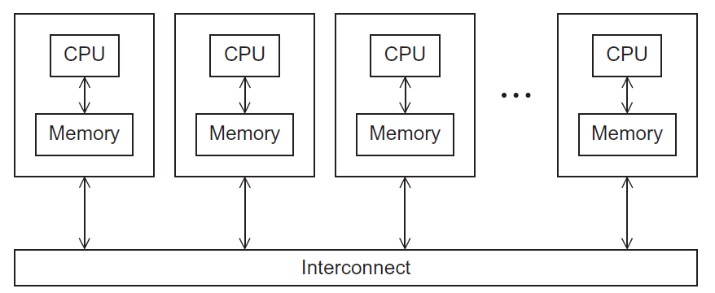
Distributed Memory System
Figure 2.4

Slide 91
Interconnection networks
Affects performance of both distributed and shared memory systems.
Two categories:
Shared memory interconnects
Distributed memory interconnects

Slide 92
Shared memory interconnects
Bus interconnect
A collection of parallel communication wires together with some hardware that controls access to the bus.
Communication wires are shared by the devices that are connected to it.
As the number of devices connected to the bus increases, contention for use of the bus increases, and performance decreases.

Slide 93
Shared memory interconnects
Switched interconnect
Uses switches to control the routing of data among the connected devices.
Crossbar:
Is a relatively simple and powerful switched interconnect.
Allows simultaneous communication among different devices.
Faster than buses.
But the cost of the switches and links is relatively high.

Slide 94
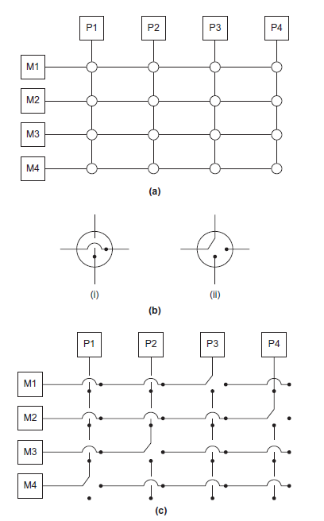
Figure 2.7
(a)
A crossbar switch connecting 4 processors (Pi) and 4 memory modules (Mj)
(b)
Configuration of internal switches in a crossbar
(c) Simultaneous memory accesses by the processors

Slide 95
Distributed memory interconnects
Distributed-memory interconnects are divided into two groups: direct inter connects and indirect interconnects.
Direct interconnect
Each switch is directly connected to a processor memory pair, and the switches are connected to each other.
Indirect interconnect
Switches may not be directly connected to a processor.

Slide 96
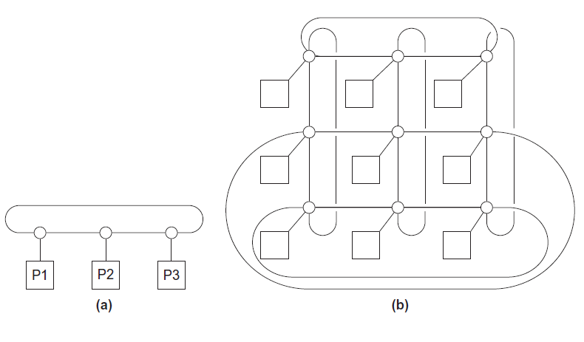
Direct interconnect
Figure 2.8
Ring
Toroidal mesh
The simplest measure of the power of a directed interconnect is the number of links.
we can usually just add the number of processors to the number of switch-to-switch links.
So in the diagram for a ring (Fig. 2.8a), we would ordinarily count 3 links instead of 6, and in the diagram for the toroidal mesh (Fig. 2.8b), we would count 18 links instead of 27.

Slide 97
Bisection width
Bisection width is the minimum number of links that must be cut to divide the network into two equal halves.
It is a key metric because it tells us about the communication capacity of the network.
A measure of “number of simultaneous communications” or “connectivity” is Bisection width.
How many simultaneous communications can take place “across the divide” between the halves?

Slide 98
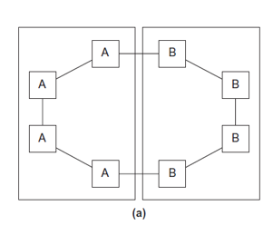
Two bisections of a ring
we’ve divided a ring with eight nodes into two groups of four nodes, and we can see that only two communications can take place between the halves.
Figure 2.9

Slide 99
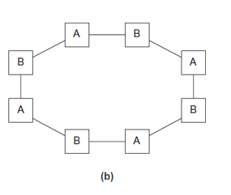
Two bisections of a ring
we’ve divided the nodes into two parts so that four simultaneous communications can take place.
Figure 2.9

Slide 100
A bisection of a toroidal mesh
An alternative way of computing the bisection width is to remove the minimum number of links needed to split the set of nodes into two equal halves. The number of links removed is the bisection width.
If we have a square two-dimensional toroidal mesh with p = q² nodes (where q is even), then we can split the nodes into two halves by removing the “middle” horizontal links and the “wraparound” horizontal links.

Slide 101
A bisection of a toroidal mesh
This suggests that the bisection width is at most 2q = 2√p.
This is the smallest possible number of links, and the bisection width of a square two-dimensional toroidal mesh is 2√p.
Figure 2.10

Slide 102
Definitions
Bandwidth of a link is the rate at which a link can transmit data.
Usually given in megabits or megabytes per second.
Bisection bandwidth
A measure of network quality.
It’s similar to bisection width. However, instead of counting the number of links joining the halves, it sums the bandwidth of the links.

Slide 103
Fully connected network
Each switch is directly connected to every other switch.
It’s impractical to construct such an interconnect for systems with more than a few nodes,
bisection width = p²/4
Figure 2.11

Slide 104
Hypercube
Highly connected direct interconnect that has been used in actual systems.
Built step by step:
A one-dimensional hypercube is a fully-connected system with two processors.
A two-dimensional hypercube is built from two one-dimensional hypercubes by joining “corresponding” switches.
Similarly a three-dimensional hypercube is built from two two-dimensional hypercubes.

Slide 105
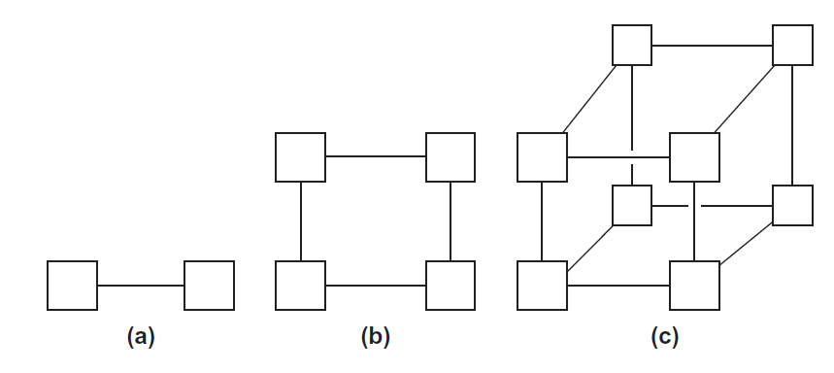
Hypercubes
Figure 2.12
One-
Two-
Three-dimensional Hypercube

Slide 106
Hypercubes
Thus a hypercube of dimension d has
p = 2^{d} nodes, and a switch in a d-dimensional hypercube is directly connected to a processor and d switches.

Slide 107
Indirect interconnects
In an indirect interconnect, the switches may not be directly connected to a processor. They’re often shown with unidirectional links and a collection of processors, each of which has an outgoing and an incoming link, and a switching network shown in fig 2.13.
Simple examples of indirect networks:
Crossbar
Omega network

Slide 108
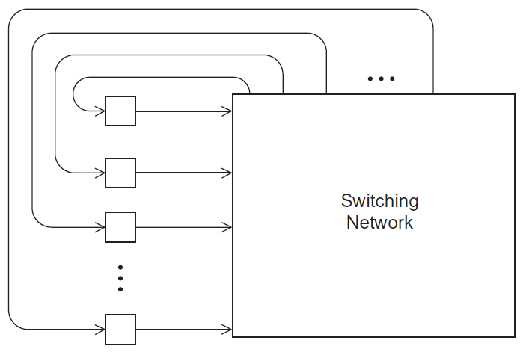
A generic indirect network
Figure 2.13

Slide 109
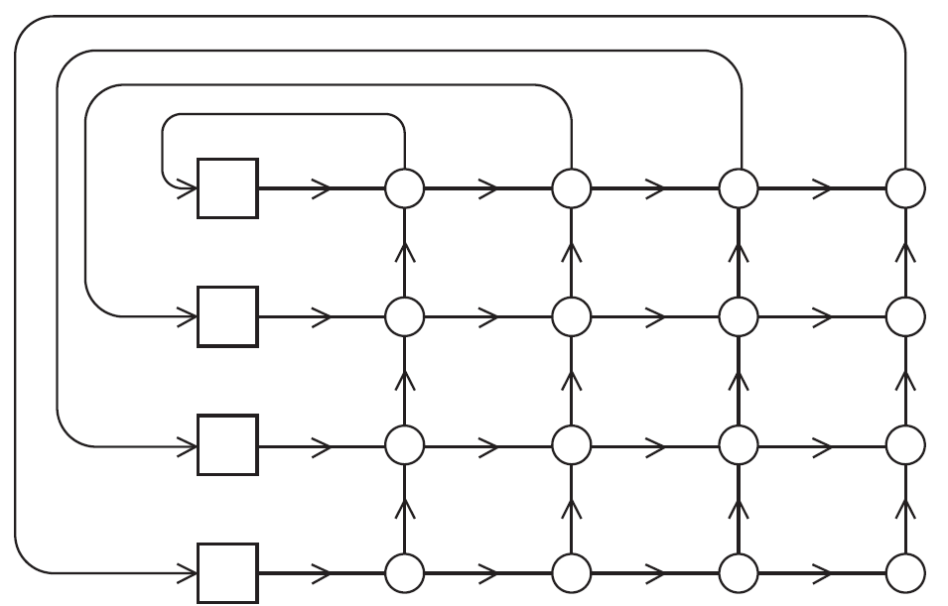
Crossbar interconnect for distributed memory
A distributed-memory crossbar shown below has unidirectional links. Notice that as long as two processors don’t attempt to communicate with the same processor, all the processors can simultaneously communicate with another processor.
Figure 2.14

Slide 110
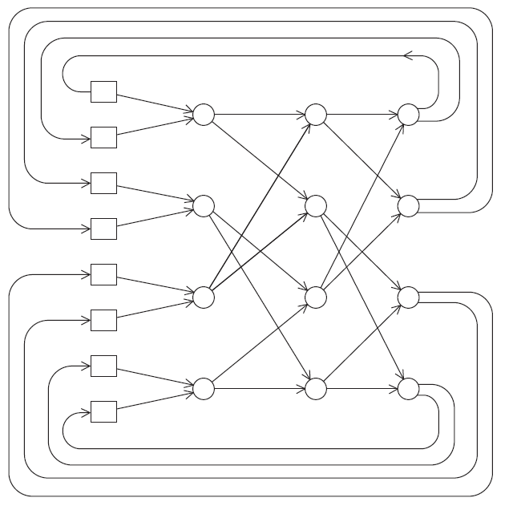
An omega network
The switches are two by two crossbars
The communications cannot occur simultaneously.
If processor 0 sends a message to processor 6, then processor 1 cannot simultaneously send a message to processor 7.
The omega network uses ½ plog₂(p) of the 2 ×2 crossbar switches, so it uses a total of 2plog₂(p) switches, while the crossbar uses p².
Figure 2.15

Slide 111

A switch in an omega network
It’s a little bit more complicated to define bisection width for indirect networks.
However, the principle is the same:
we want to divide the nodes into two groups of equal size and determine how much communication can take place between the two halves, or alternatively,
The minimum number of links that need to be removed so that the two groups can’t communicate.
The bisection width of a p×p crossbar is p, and the bisection width of an omega network is p/2.
Figure 2.16

Slide 112
More definitions
Any time data is transmitted, we’re interested in how long it will take for the data to reach its destination.
Transmitting data between main memory and cache, cache and register, hard disk and memory or between two nodes in a distributed memory.
The performance of an interconnect is measured in terms of
Latency
The time that elapses between the source’s beginning to transmit the data and the destination’s starting to receive the first byte.
Bandwidth
The rate at which the destination receives data after it has started to receive the first byte.

Slide 113
If the latency of an interconnect is l seconds and the bandwidth is b bytes per second, then the time it takes to transmit a message of n bytes is
Message transmission time = l + n / b
latency (seconds)
length of message (bytes)
bandwidth (bytes per second)

Slide 114
Cache coherence
Cache coherence is a fundamental concept in multiprocessor and multicore systems.
It ensures that multiple caches storing copies of the same memory location remain consistent.
Without cache coherence, different processors could see stale or conflicting values, leading to incorrect program execution.
In a multiprocessor system, each core may have its own private cache.
When one core updates a memory location in its cache, other cores may still hold the old value in their caches.
If there is no mechanism to maintain consistency, different processors may work with different values of the same variable data inconsistency.

Slide 115

Cache coherence
Programmers have no control over caches and when they get updated.
Figure 2.17
A shared memory system with two cores and two caches

Slide 116

Cache coherence
y0 privately owned by Core 0
y1 and z1 privately owned by Core 1
x = 2; /* shared variable */
y0 eventually ends up = 2
y1 eventually ends up = 6
z1 = ???

Slide 117
Cache coherence
.
.
The unpredictable behavior will occur regardless of whether the system is using a write-through or a write-back policy.
write-through :When the CPU writes data to the cache, the same data is immediately written to the main memory as well.
Every write operation updates both:
The cache copy, and
The corresponding location in main memory.
This ensures that main memory always has the most recent data
If it’s using a write-through policy, the main memory will be updated by the assignment x =7. However, this will have no effect on the value in the cache of core 1.
write-back policy: When the CPU writes data to the cache, the update is made only in the cache, and the modified block is written back to main memory only when it is replaced (evicted).
A cache line has a "dirty bit" that indicates whether the data has been modified.
When the line is replaced (evicted), if the dirty bit = 1, the cache writes the data to main memory
If the system is using a write-back policy, the new value of x in the cache of core 0 probably won’t even be available to core 1 when it updates z1.

Slide 118
Cache coherence
Feature | Write-Through | Write-Back
Write location | Cache + Memory | Cache only
Memory updated | Immediately | On replacement (eviction)
Memory traffic | High | Low
Speed | Slower writes | Faster writes
Complexity | Simple | Complex
Coherence handling | Easier | Requires protocol (MESI, etc.)
Use case | Simpler systems or where data consistency is critical | High-performance multiprocessor systems

Slide 119
Cache coherence
When the caches of multiple processors store the same variable, an update by one processor to the cached variable is “seen” by the other processors. That is, that the cached value stored by the other processors is also updated. This is called the cache coherence problem.

Slide 120
Cache coherence
Cache Coherence Protocols
Cache coherence protocols, broadly classified it into two types:
Snooping Protocols
Each cache monitors (snoops) the system’s bus to see if other cores are reading/writing the same memory block.
Based on updates, caches invalidate or update their copies.
Common examples: Write-invalidate, Write-update.
Protocols: MSI((Modified, Shared, Invalid), MESI (Modified, Exclusive, Shared, Invalid), MOESI (Modified, Owned, Exclusive, Shared, Invalid), MESIF (Modified, Exclusive, Shared, Invalid, Forward).

Slide 121
Snooping Cache Coherence
The snooping comes from bus based system.
When the cores share a bus, any signal transmitted on the bus can be “seen” by all cores connected to the bus.
When core 0 updates the copy of x stored in its cache it also broadcasts this information across the bus.
If core 1 is “snooping” the bus, it will see that x has been updated and it can mark its copy of x as invalid.
Snooping protocol broadcast only informs the other cores that the cache line containing x has been updated, not that x has been updated

Slide 122
Snooping Cache Coherence
In a bus-based system, snooping works because all cores share the same bus. Any signal placed on the bus can be observed by every core connected to it.
When Core 0 updates the value of x in its cache, it broadcasts a coherence message across the bus. If Core 1 is snooping the bus, it detects this broadcast and realizes that its own cached copy of x is now stale. Core 1 then marks its copy as invalid.
Importantly, the snooping protocol broadcast does not send the new value of x. Instead, it only informs other cores that the cache line containing x has changed, so they must either invalidate or update their own copies when needed.

Slide 123
Snooping Cache Coherence
A couple of points should be made regarding snooping:
It’s not essential that the interconnect be a bus, only that it support broadcasts from each processor to all the other processors.
snooping works with both write-through and write back caches.
If the interconnect is shared—as with a bus—with write through caches there’s no need for additional traffic on the interconnect, since each core can simply “watch” for writes.
With write-back caches, an extra communication is necessary, since updates to the cache don’t get immediately sent to memory.

Slide 124
Directory Based Cache Coherence
Directory-Based Protocols
Instead of broadcasting to all caches, a central directory keeps track of which cores have cached a block.
On a write, the directory notifies only relevant caches.
More scalable than snooping, especially in large systems.
Snooping cache coherence requires a broadcast every time a variable is updated. So snooping cache coherence isn’t scalable, because for larger systems it will cause performance to degrade.
For example, suppose we have a system with the basic distributed-memory architecture. However, the system provides a single address space for all the memories.
snooping cache coherence is clearly a problem since a broadcast across the interconnect will be very slow relative to the speed of accessing local memory.

Slide 125
Directory Based Cache Coherence
Uses a data structure called a directory that stores the status of each cache line.
This data structure is distributed.
When a variable is updated, the directory is consulted, and the cache controllers of the cores that have that variable’s cache line in their caches will invalidated those lines.
There will be substantial additional storage required for the directory, but when a cache variable is updated, only the cores storing that variable need to be contacted.

Slide 126
False sharing
CPU caches are implemented in hardware, so they operate on cache lines, not individual variables.
suppose we want to repeatedly call a function f(i,j) and add the computed values into a vector:
int i, j, m, n;
double y[m];
/ ∗ Assign y = 0 ∗/
for (i = 0; i < m; i++)
for (j = 0; j < n; j++)
y [i] += f(i,j);

Slide 127
False sharing:
/ ∗ Private variables ∗/
int i, j, iter_count;
/ ∗ Shared variables initialized by one core ∗/
int m, n, core_count ;
double y[m];
iter_count = m/ core_count;
/ ∗ Core 0 does this ∗/
for (i = 0; i < iter_count; i++)
for (j = 0; j < n; j++)
y [i] += f(i,j);
/ ∗ Core 1 does this ∗/
for (i = iter_count; i < 2∗iter_count; i++)
for (j = 0; j < n; j++)
y [i] += f(i,j);

Slide 128
False sharing
Since, y is stored in a single cache line, each time one of the cores executes the statement
y[i] +=f(i,j), the line will be invalidated,
The next time the other core tries to execute this statement, it will have to fetch the updated line from memory!
So if n is large, a large percentage of the assignments
y[i] +=f(i,j)
will access main memory in spite of the fact that core 0 and core 1 never access each other’s elements of y. This is called False sharing, because the system is behaving as if the elements of y were being shared by the cores.

Slide 129
False sharing
False sharing does not cause incorrect results. However, it can ruin the performance of a program by causing many more accesses to main memory than necessary.
We can reduce its effect by using temporary storage that is local to the thread or process, and then copying the temporary storage to the shared storage.

Slide 130
Shared vs. distributed-memory
There are several issues, about software for distributed- and shared-memory.
However, the principal hardware issue is the cost of scaling the interconnect.
As we add processors to a bus, the chance that there will be conflicts over access to the bus increase dramatically, so buses are suitable for systems with only a few processors.
Large crossbars are very expensive, so it’s also unusual to find systems with large crossbar interconnects.

Slide 131
Shared vs. distributed-memory
On the other hand, distributed-memory interconnects, such as the hypercube and the toroidal mesh, are relatively inexpensive, and distributed-memory systems with thousands of processors that use these and other interconnects have been built.
Thus distributed-memory systems are often better suited for problems requiring vast amounts of data or computation.

